Slide 1

Chapter 5: Top-Down Parsing
陳奇業 成功大學資訊工程系

Slide 2
Objectives of Top-Down Parsing
an attempt to find a leftmost derivation for an input string.
an attempt to construct a parse tree for the input string starting from the root and creating the nodes of the parse tree in preorder.

Slide 3
Objectives of Top-Down Parsing
In this chapter, we study the following two forms of top-down parsers:
Recursive-descent parsers contain a set of mutually recursive procedures that cooperate to parse a string. Code for these procedures can be written directly from a suitable grammar.
Table-driven LL parsers use a generic LL(k) parsing engine and a parse table that directs the activity of the engine. The entries for the parse table are determined by the particular LL(k) grammar. The notation LL(k) is explained below.

Slide 4
The Basic Method of Recursive-Descent

Slide 5

Using EBNF
Consider now the case of an $exp⁡$ in the grammar for simple arithmetic expressions in BNF:
$$exp→\exp{addop term | term}$$
The solution is to use the EBNF rule
$$exp→term\left\{addop term\right\}$$

Slide 6
Syntax Tree

Slide 7
Syntax Tree
We consider the expression 3+4+5

Slide 8
Approaches of Top-Down Parsing
with backtracking (making repeated scans of the input, a general form of top-down parsing)
Methods: To create a procedure for each nonterminal.

Slide 9
Problems for top-down parsing with backtracking

Slide 10
L = { cabd, cad }
e.g. S -> cAd A -> ab | a
S( ) { if input symbol == ‘c’ A( ) { isave= input-pointer;
{ Advance(); if input-symbol == ‘a’
if A() { Advance();
if input-symbol == ‘d’ if input-symbol == ‘b’
{ Advance(); { Advance();
return true; return true;
} }
} }
return false; input-pointer = isave;
} if input-symbol == ‘a’
{ Advance();
return true; }
else
return false;
}
c
a
d

Slide 11
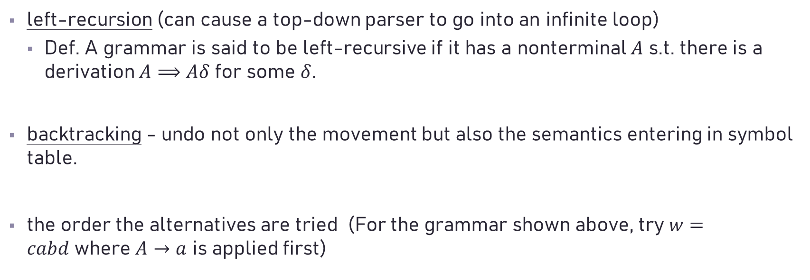
Problems for top-down parsing with backtracking
left-recursion (can cause a top-down parser to go into an infinite loop)
Def. A grammar is said to be left-recursive if it has a nonterminal $A$ s.t. there is a derivation $A⟹Aδ$ for some $δ$.
backtracking - undo not only the movement but also the semantics entering in symbol table.
the order the alternatives are tried (For the grammar shown above, try $w=cabd$where $A→a$ is applied first)

Slide 12

The LL(1) Predict Function
Given the productions
$$A→α_{1}$$
$$A→α_{2}$$
$$⋯$$
$$A→α_{n}$$
During a (leftmost) derivation
$⋯A⋯⇒…α_{1}⋯$ or
$⋯α_{2}⋯$ or
$⋯$ or
$⋯α_{n}⋯$
Deciding which production to match
Using lookahead symbols

Slide 13
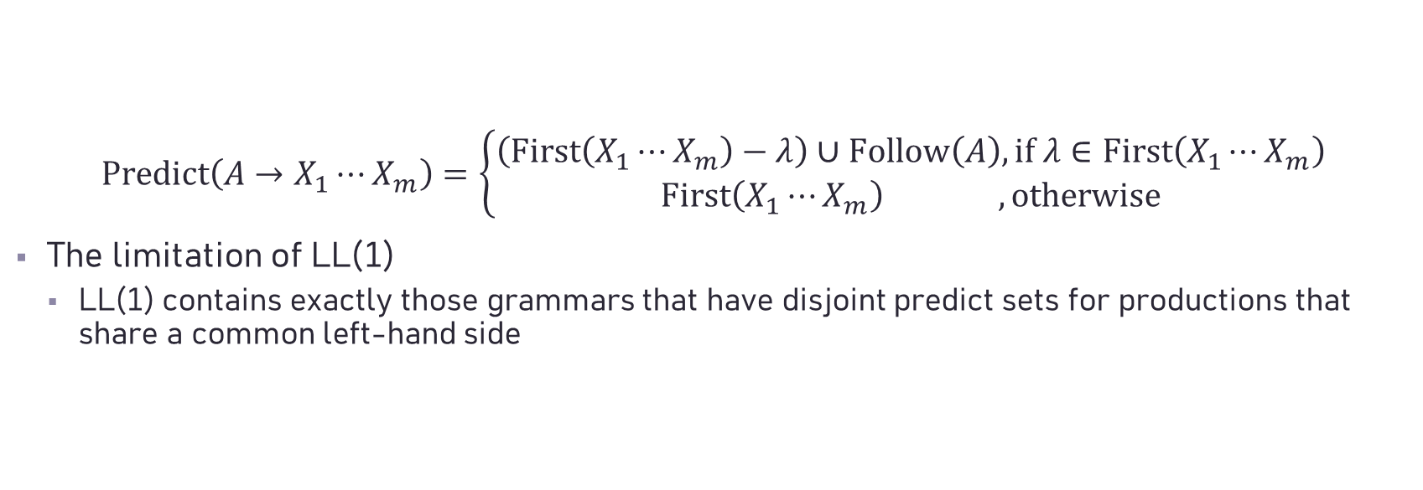
The LL(1) Predict Function
$$Predict\left(A→X_{1}⋯X_{m}\right)=\left\{\begin{aligned}\left(First\left(X_{1}⋯X_{m}\right)−λ\right)∪Follow\left(A\right), if λ∈First\left(X_{1}⋯X_{m}\right) \\ First\left(X_{1}⋯X_{m}\right) , otherwise\end{aligned}\right.$$
The limitation of LL(1)
LL(1) contains exactly those grammars that have disjoint predict sets for productions that share a common left-hand side
Single Symbol Lookahead

Slide 14
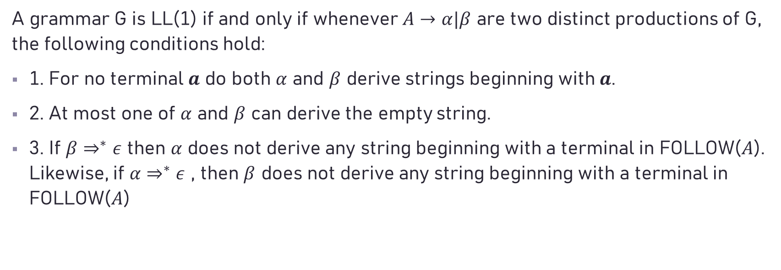
A grammar G is LL(1) if and only if whenever $A→α|β$ are two distinct productions of G, the following conditions hold:
1. For no terminal $a$ do both $α$ and $β$ derive strings beginning with $a$.
2. At most one of $α$ and $β$ can derive the empty string.
3. If $β⇒^{∗}ε$ then $α$ does not derive any string beginning with a terminal in FOLLOW($A$). Likewise, if $α⇒^{∗}ε$ , then $β$ does not derive any string beginning with a terminal in FOLLOW($A$)

Slide 15
The LL(1) Predict Function

Slide 16
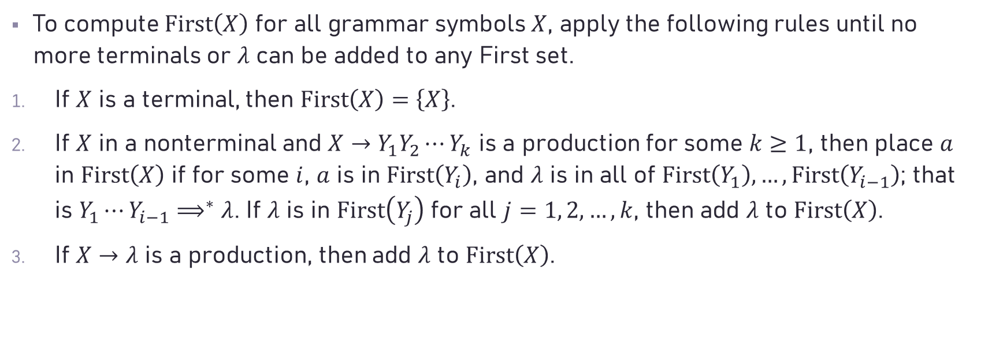
First set
To compute $First\left(X\right)$ for all grammar symbols $X$, apply the following rules until no more terminals or $λ$ can be added to any First set.
If $X$ is a terminal, then $First\left(X\right)=\left\{X\right\}$.
If $X$ in a nonterminal and $X→Y_{1}Y_{2}⋯Y_{k}$ is a production for some $k≥1$, then place $a$ in $First\left(X\right)$ if for some $i$, $a$ is in $First\left(Y_{i}\right)$, and $λ$ is in all of $First\left(Y_{1}\right), …,First\left(Y_{i−1}\right)$; that is $Y_{1}⋯Y_{i−1}⟹^{∗}λ$. If $λ$ is in $First\left(Y_{j}\right)$ for all $j=1, 2, …, k$, then add $λ$ to $First\left(X\right)$.
If $X→λ$ is a production, then add $λ$ to $First\left(X\right)$.

Slide 17

An Example
$E → TE^{′}$
$$E′ → +TE′| λ$$
$$T → FT^{′}$$
$$T′ → ∗FT‘ | λ$$
$$F → (E) | id$$
$$First(E) = First(T) = First(F) = \{(, id\}$$
$$First(E′) = \{+, λ\}$$
$$First(T′) = \{∗, λ \}$$

Slide 18
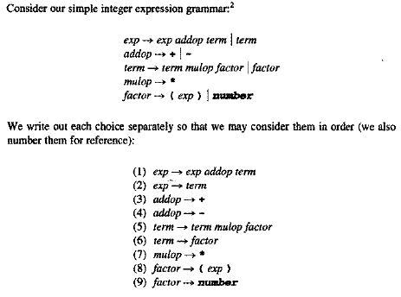


Slide 19
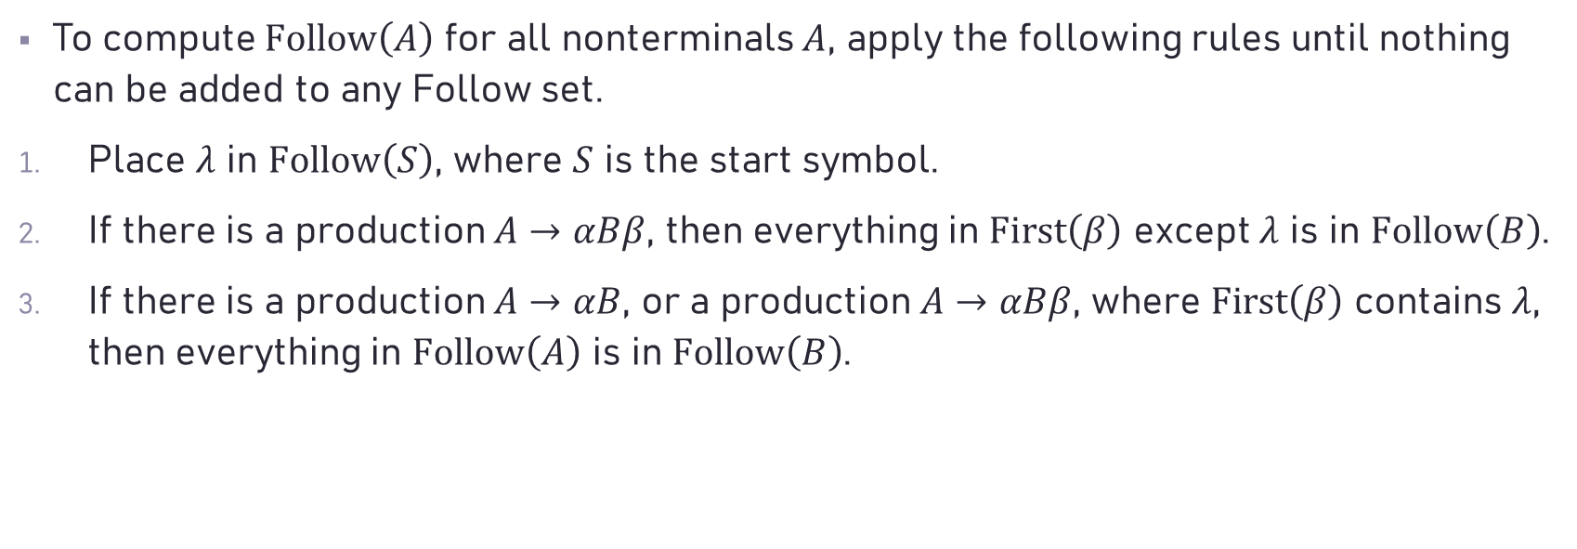
Follow set
To compute $Follow\left(A\right)$ for all nonterminals $A$, apply the following rules until nothing can be added to any Follow set.
Place $λ$ in $Follow\left(S\right)$, where $S$ is the start symbol.
If there is a production $A→αBβ$, then everything in $First\left(β\right)$ except $λ$ is in $Follow\left(B\right)$.
If there is a production $A→αB$, or a production $A→αBβ$, where $First\left(β\right)$ contains $λ$, then everything in $Follow\left(A\right)$ is in $Follow\left(B\right)$.

Slide 20
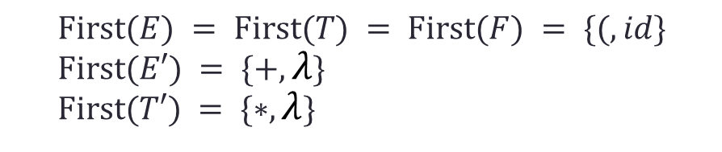

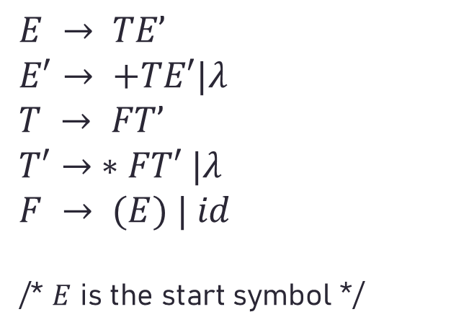
An Example
$Follow(E) = \{λ, )\}$ // rules 1 & 2
$Follow(E′) = \{λ, )\}$ // rule 3
$Follow(T) = \{ +, λ, )\}$ // rules 2 & 3
$Follow(T′) = \{ +, λ, )\}$ // rule 3
$Follow(F) = \{ ∗, +, λ, )\}$ // rules 2 & 3
$$E → TE’$$
$$E′→ +TE′|λ$$
$$T → FT’$$
$$T′→ ∗FT′ |λ$$
$$F → (E) | id$$
/* $E$ is the start symbol */
$First(E) = First(T) = First(F) = \{(, id\}$
$$First(E′) = \{+, λ\}$$
$$First(T′) = \{∗, λ\}$$

Slide 21
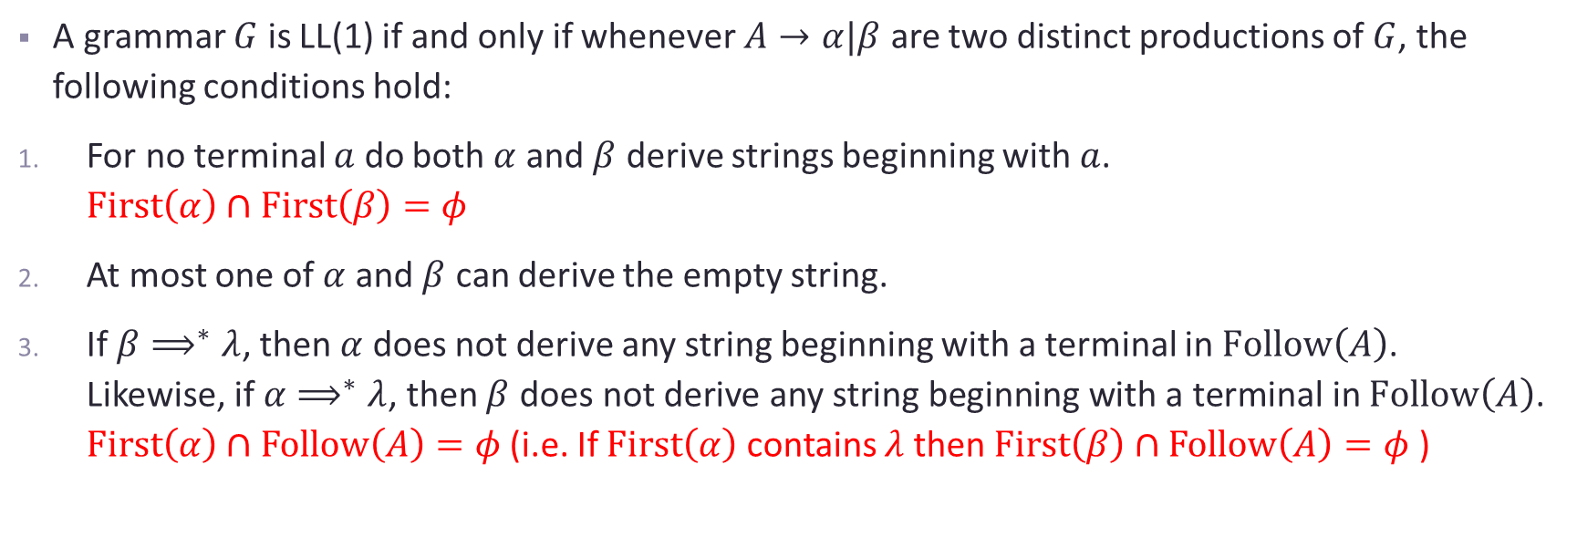
The LL(1) Predict Function
A grammar $G$ is LL(1) if and only if whenever $A→α|β$ are two distinct productions of $G$, the following conditions hold:
For no terminal $a$ do both $α$ and $β$ derive strings beginning with $a$. $First\left(α\right)∩First\left(β\right)=φ$
At most one of $α$ and $β$ can derive the empty string.
If $β⟹^{∗}λ$, then $α$ does not derive any string beginning with a terminal in $Follow\left(A\right)$. Likewise, if $α⟹^{∗}λ$, then $β$ does not derive any string beginning with a terminal in $Follow\left(A\right)$. $First\left(α\right)∩Follow\left(A\right)=φ$ (i.e. If $First\left(α\right)$ contains $λ$ then $First\left(β\right)∩Follow\left(A\right)=φ$ )
common prefixes

Slide 22
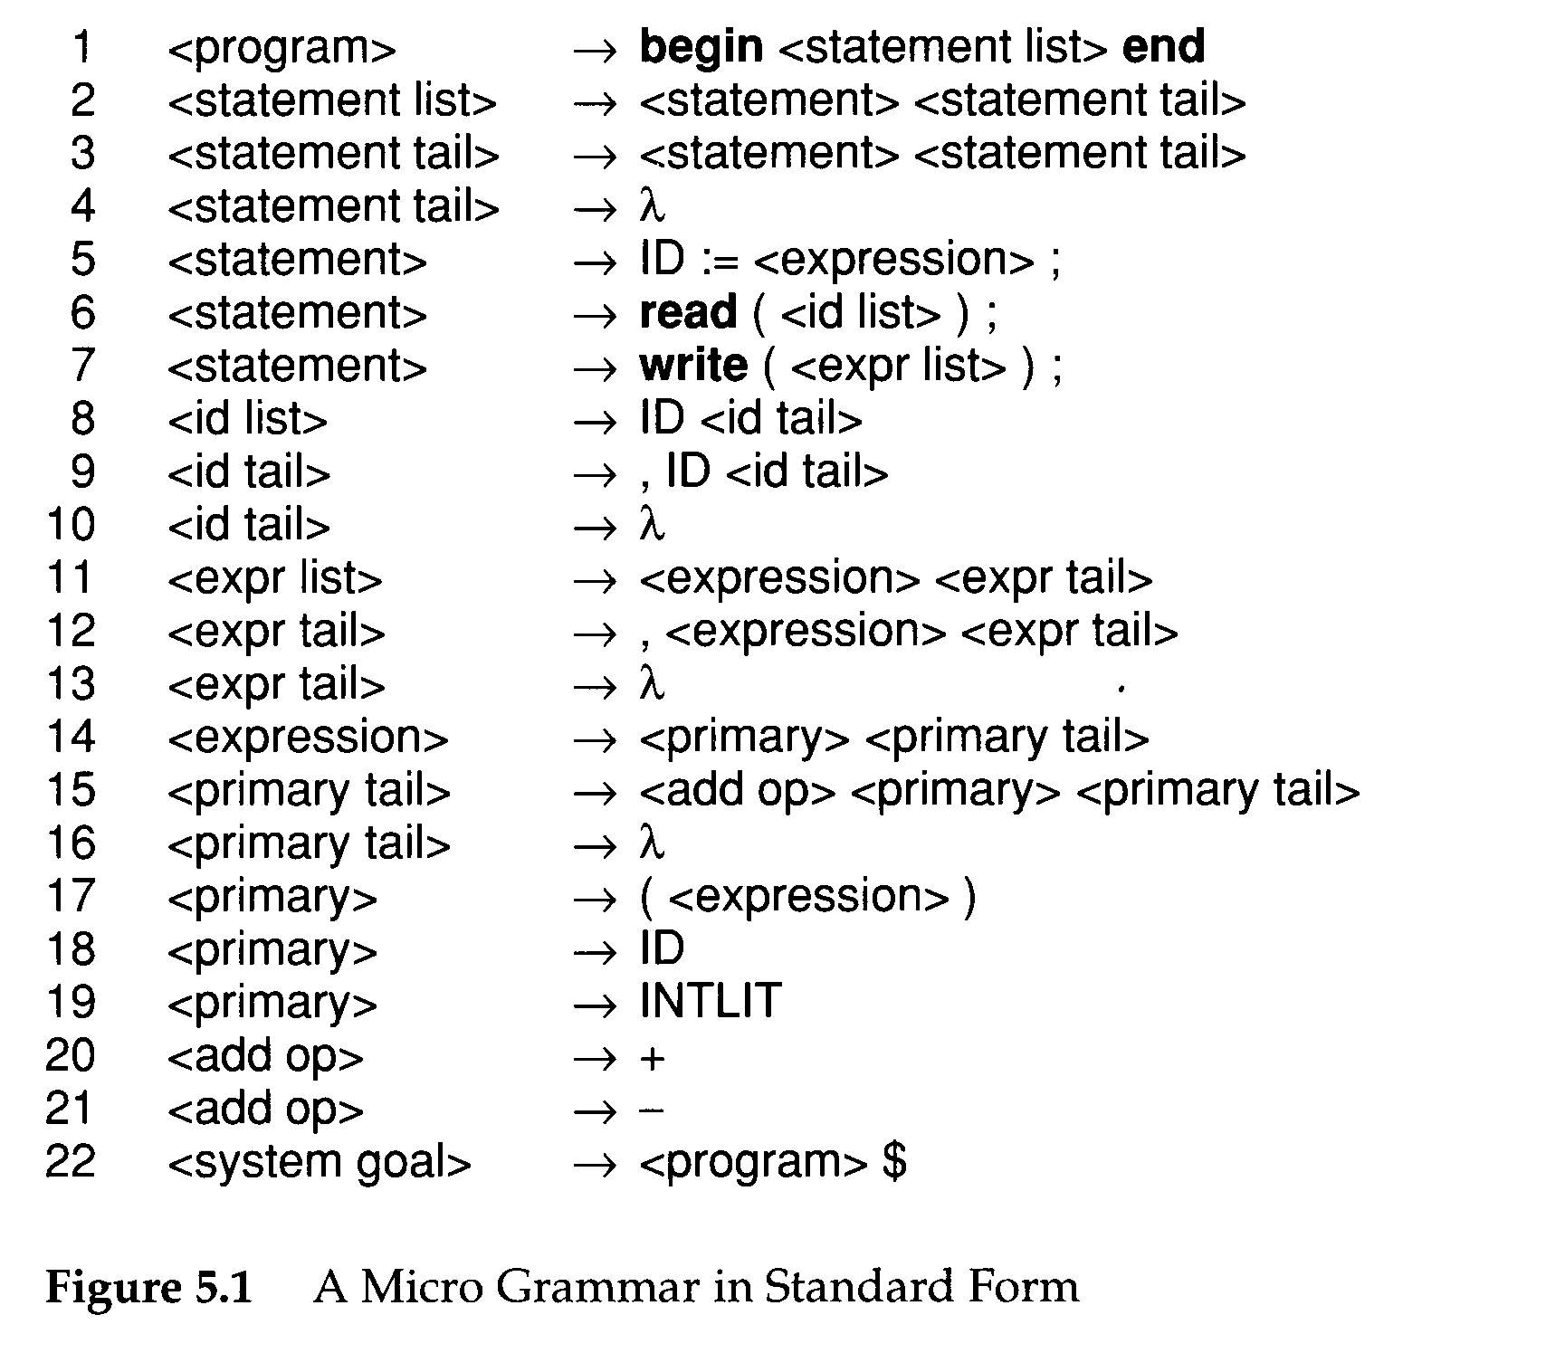
Not extended BNF form
$: end of file token

Slide 23
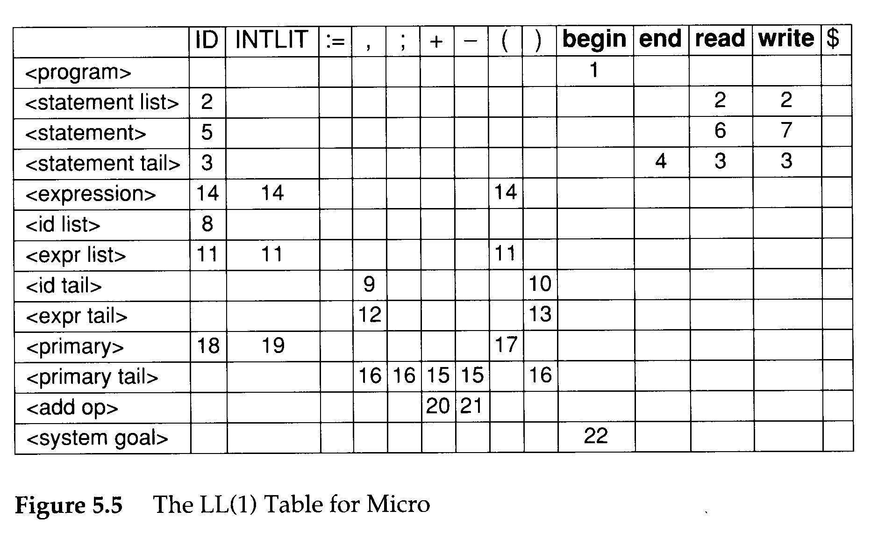

The LL(1) Parse Table
An LL(1) parse table
$$T:V_{n}×V_{t}→P∪\left\{Error\right\}$$
The definition of $T$
$T\left[A\right]\left[t\right]=A→X_{1}⋯X_{m}$ if $t∈Prediction\left(A→X_{1}⋯X_{m}\right)$;
$T\left[A\right]\left[t\right]=Error$, otherwise

Slide 24
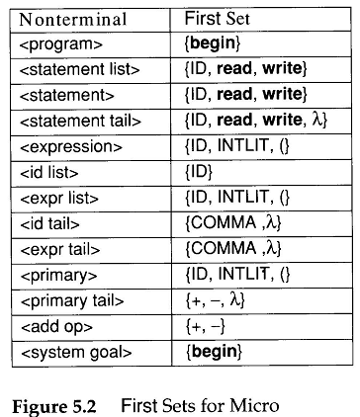
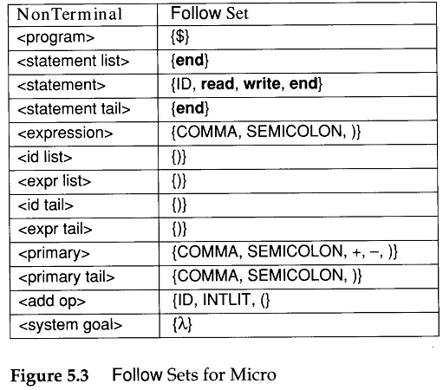

Slide 25
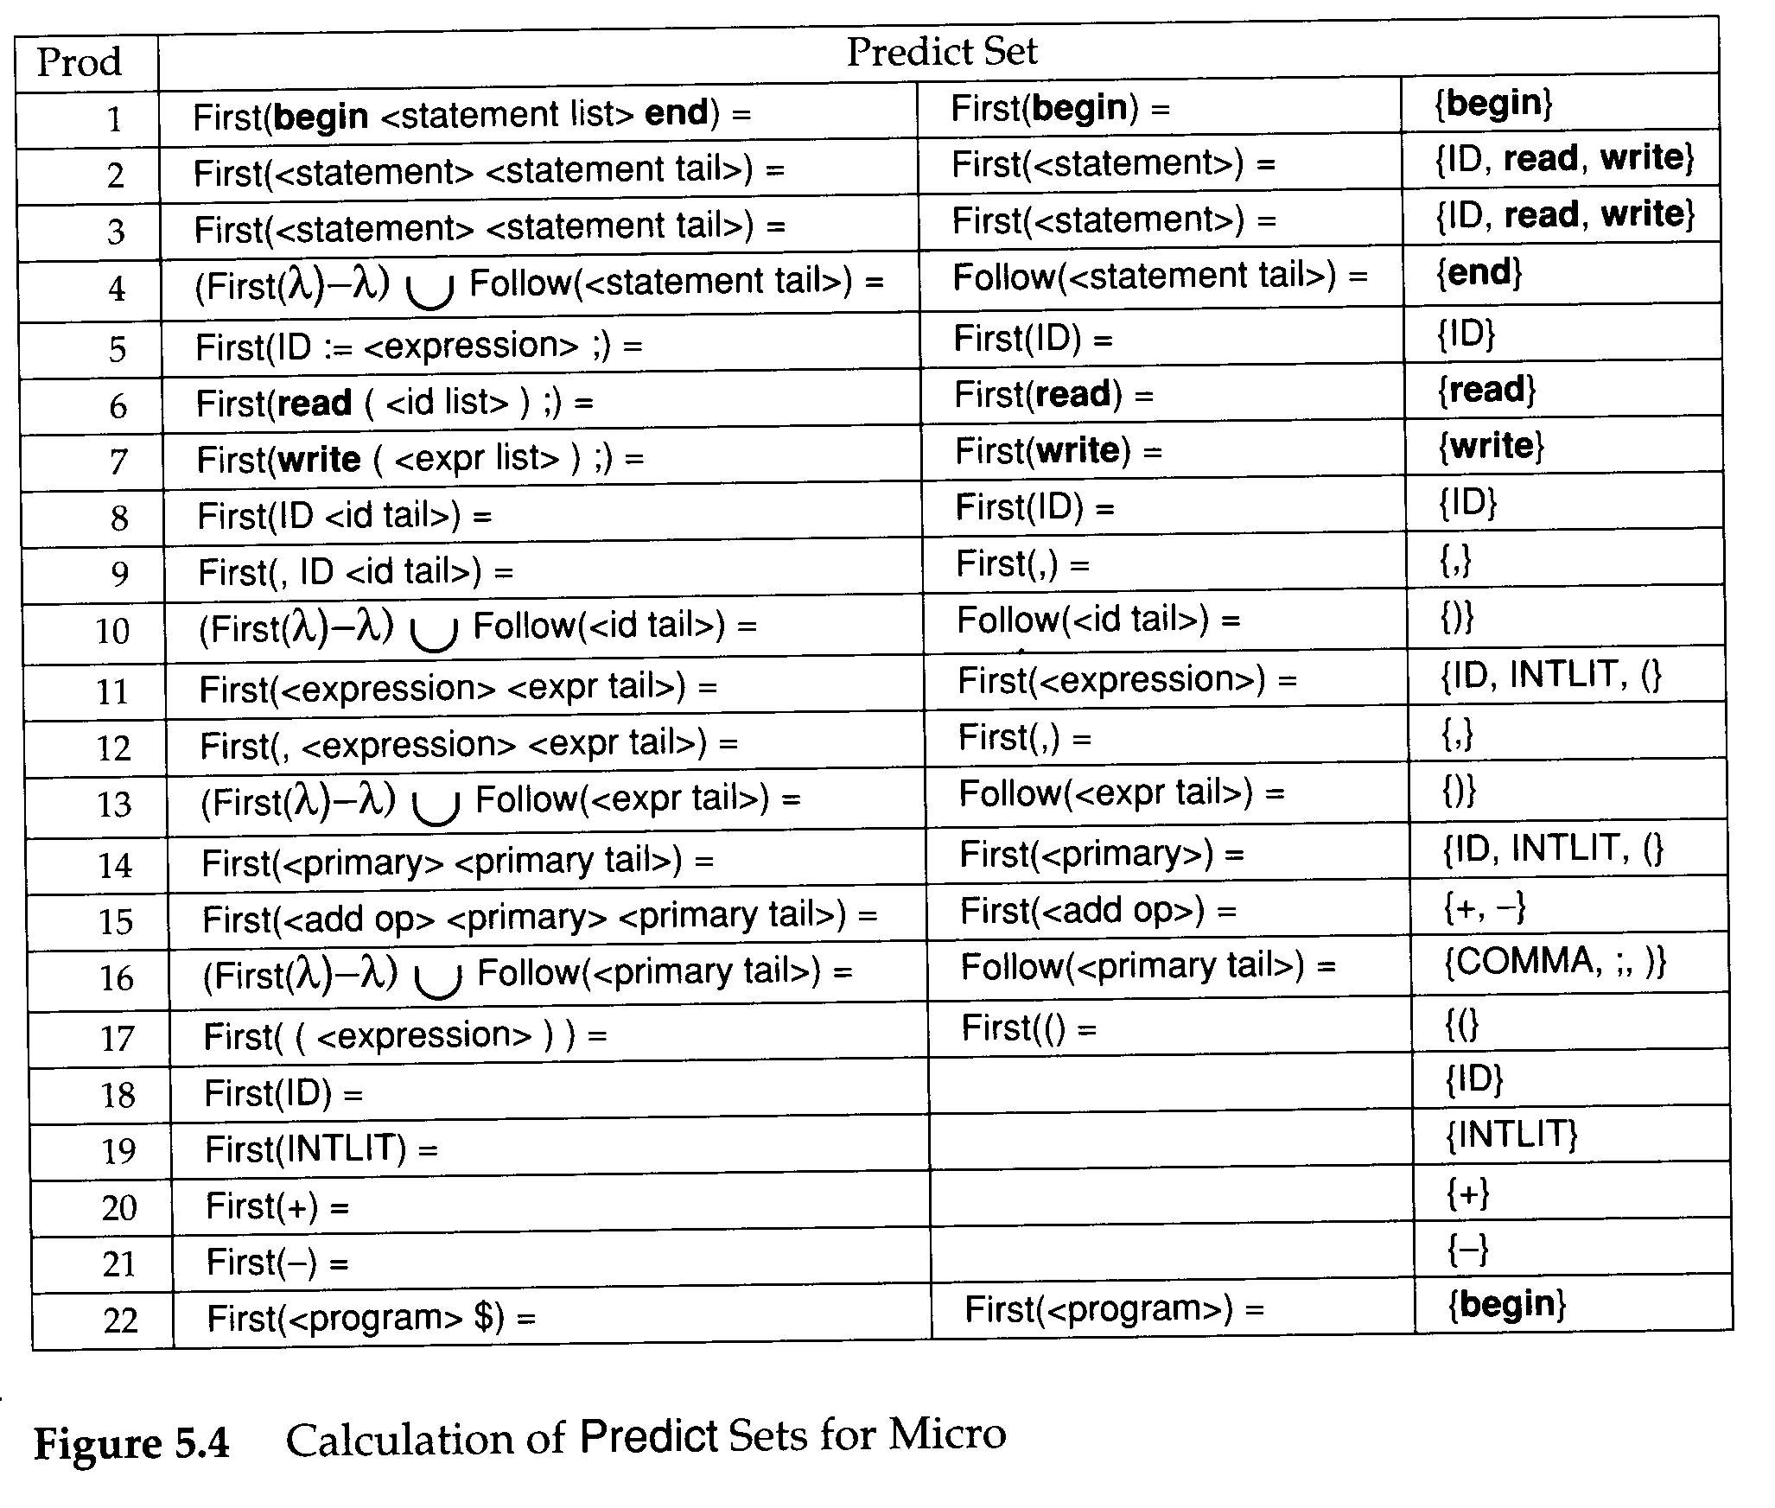

Slide 26
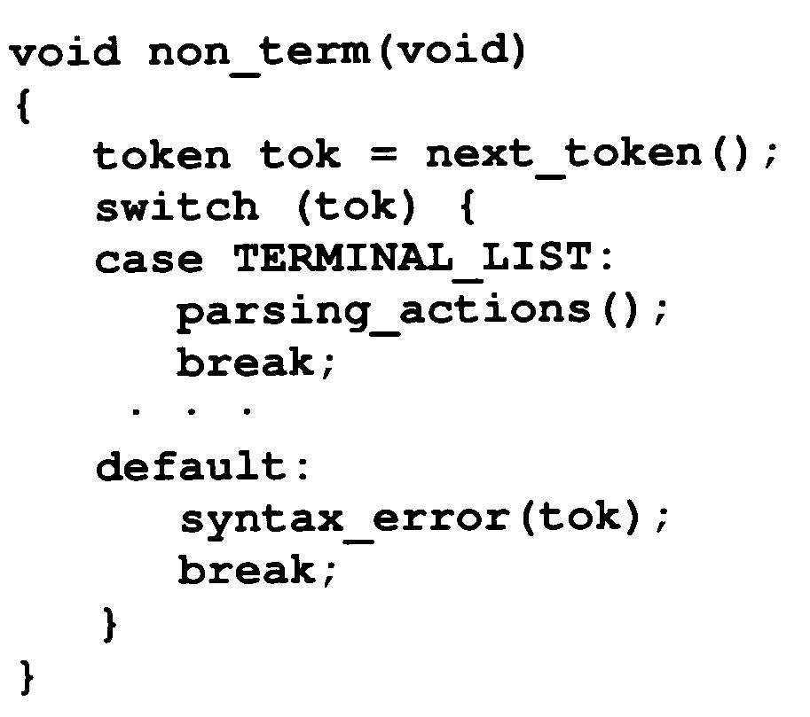
Building Recursive Descent Parsers from LL(1) Tables
The form of parsing procedure:

Slide 27
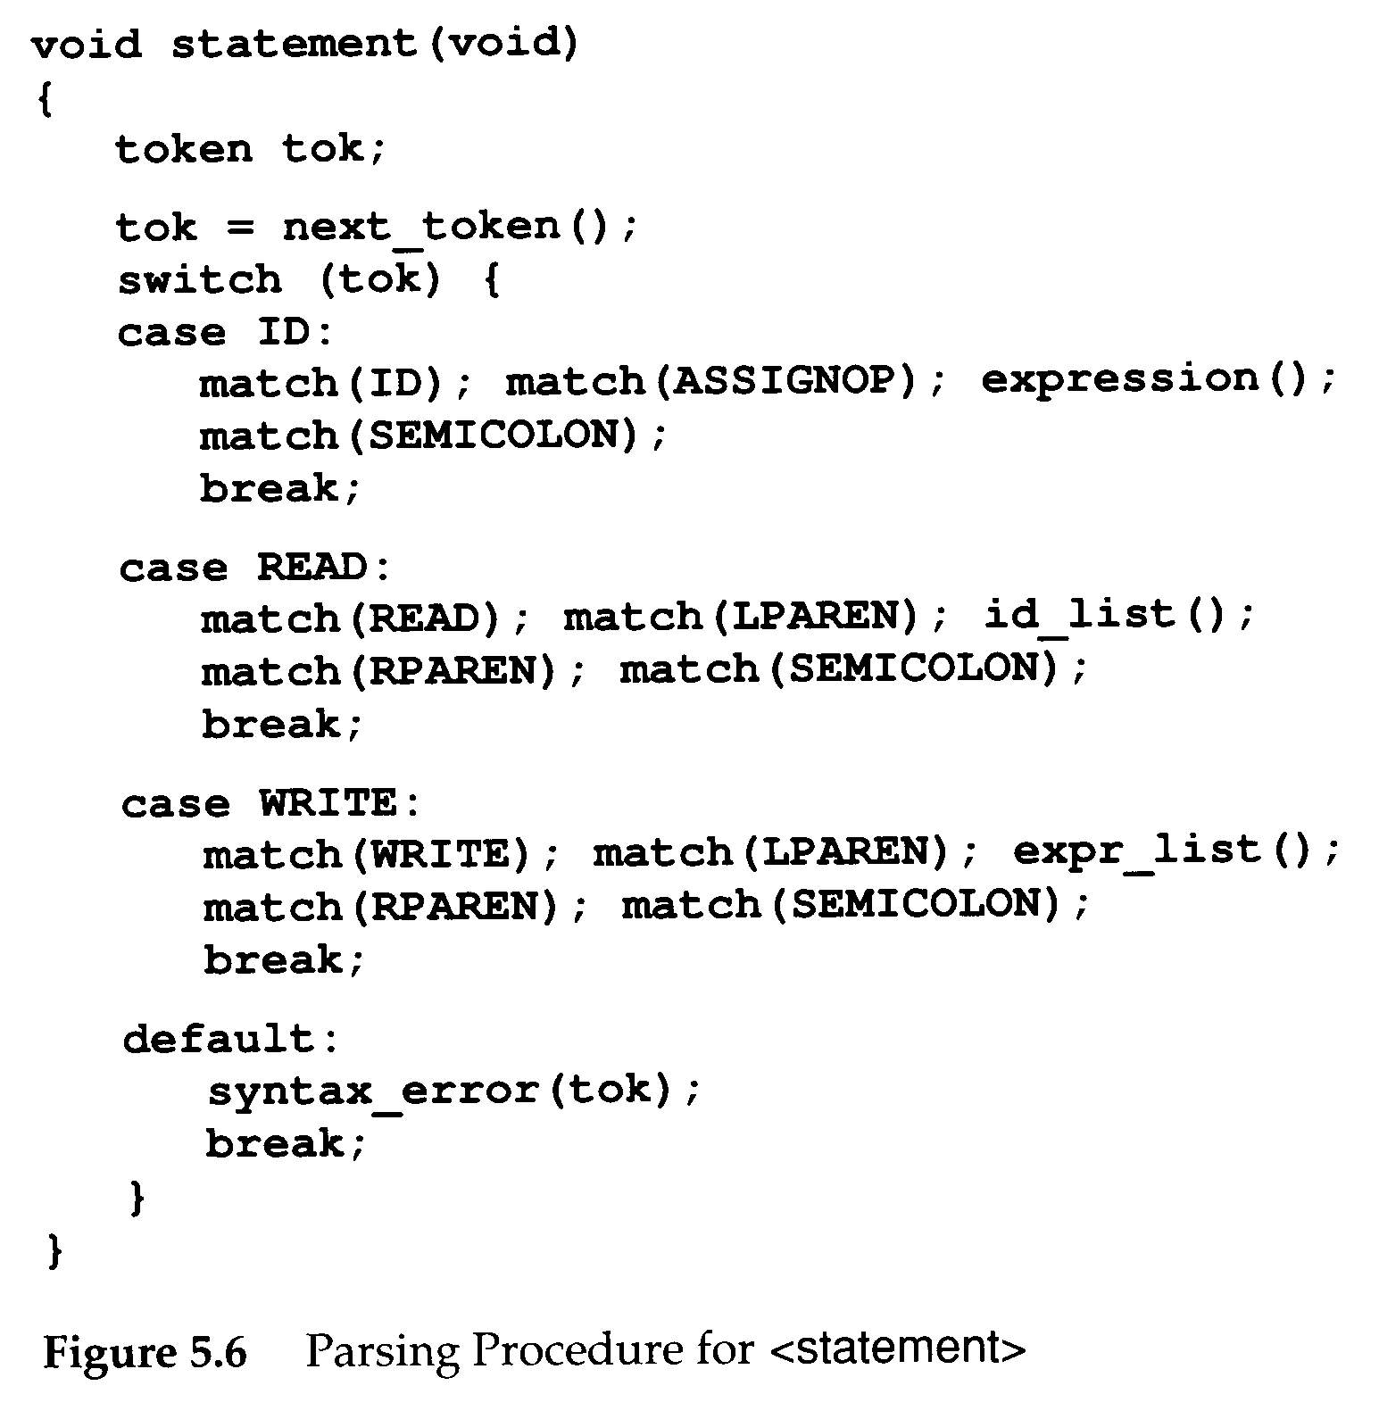
Building Recursive Descent Parsers from LL(1) Tables
E.g. of an parsing procedure for <statement> in Micro
An algorithm that automatically creates parsing procedures like the one in Figure 5.6 from LL(1) table

Slide 28
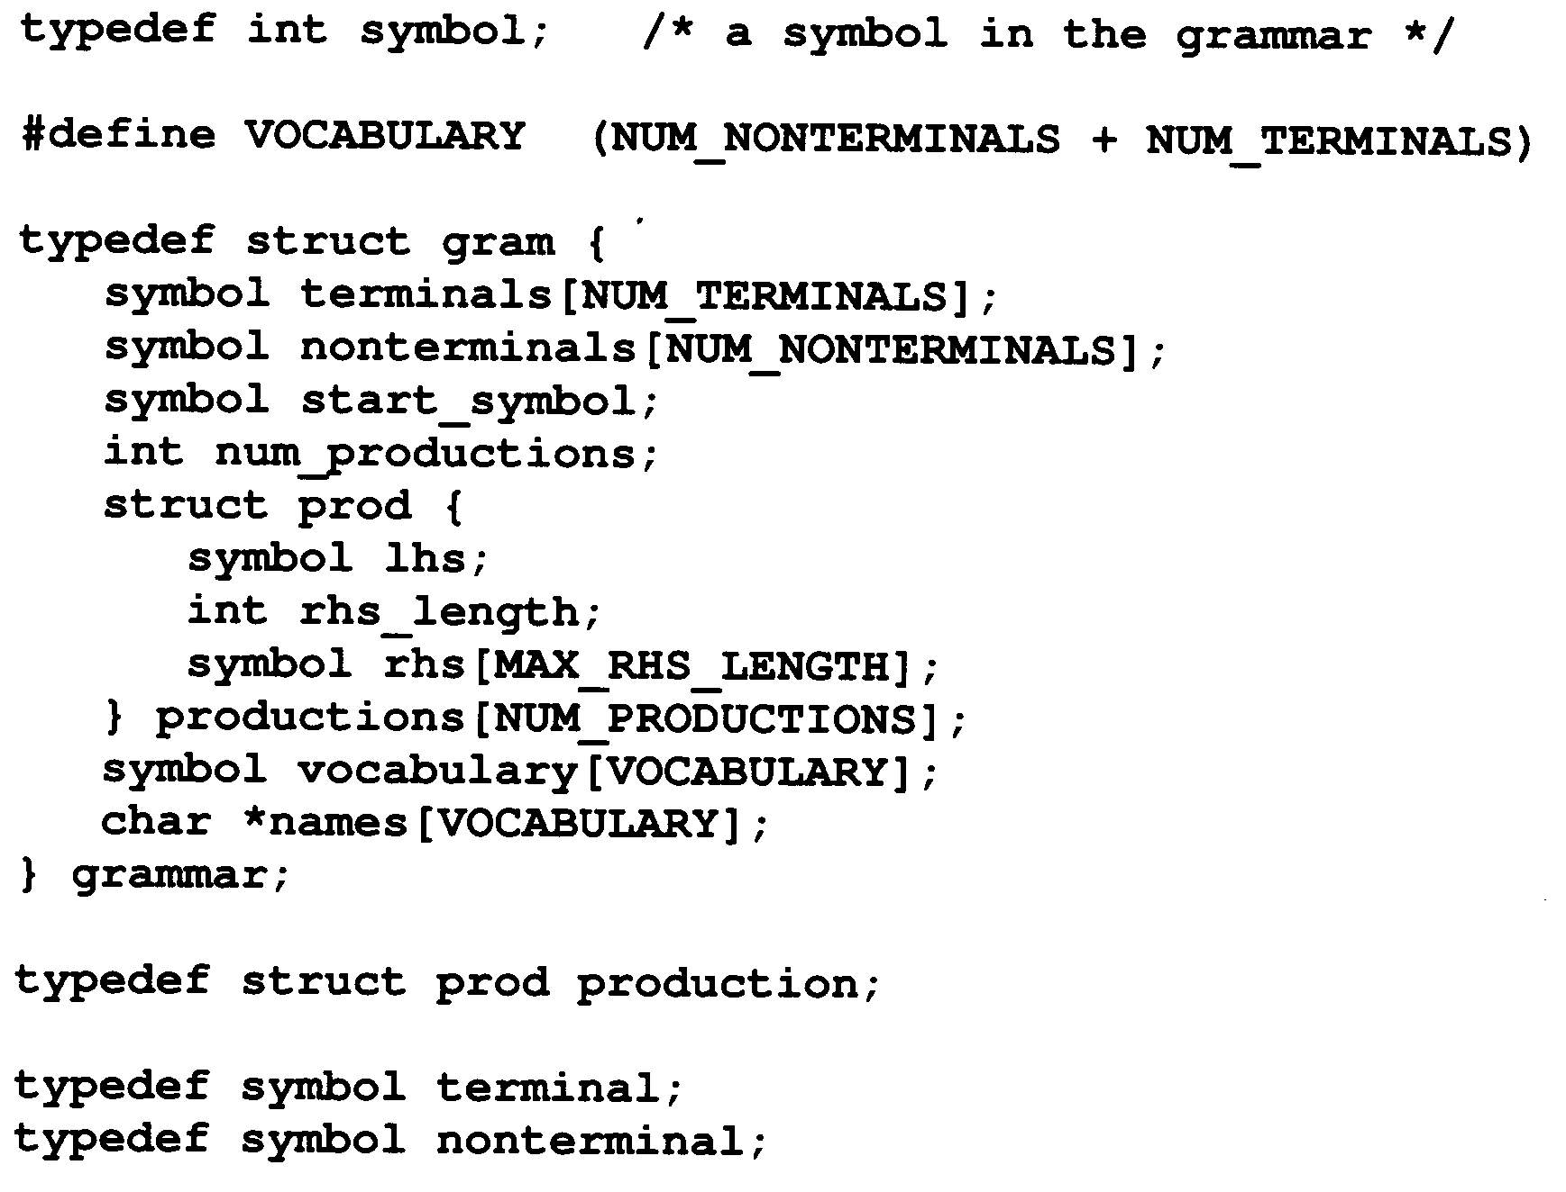
Building Recursive Descent Parsers from LL(1) Tables
The data structure for describing grammars

Slide 29
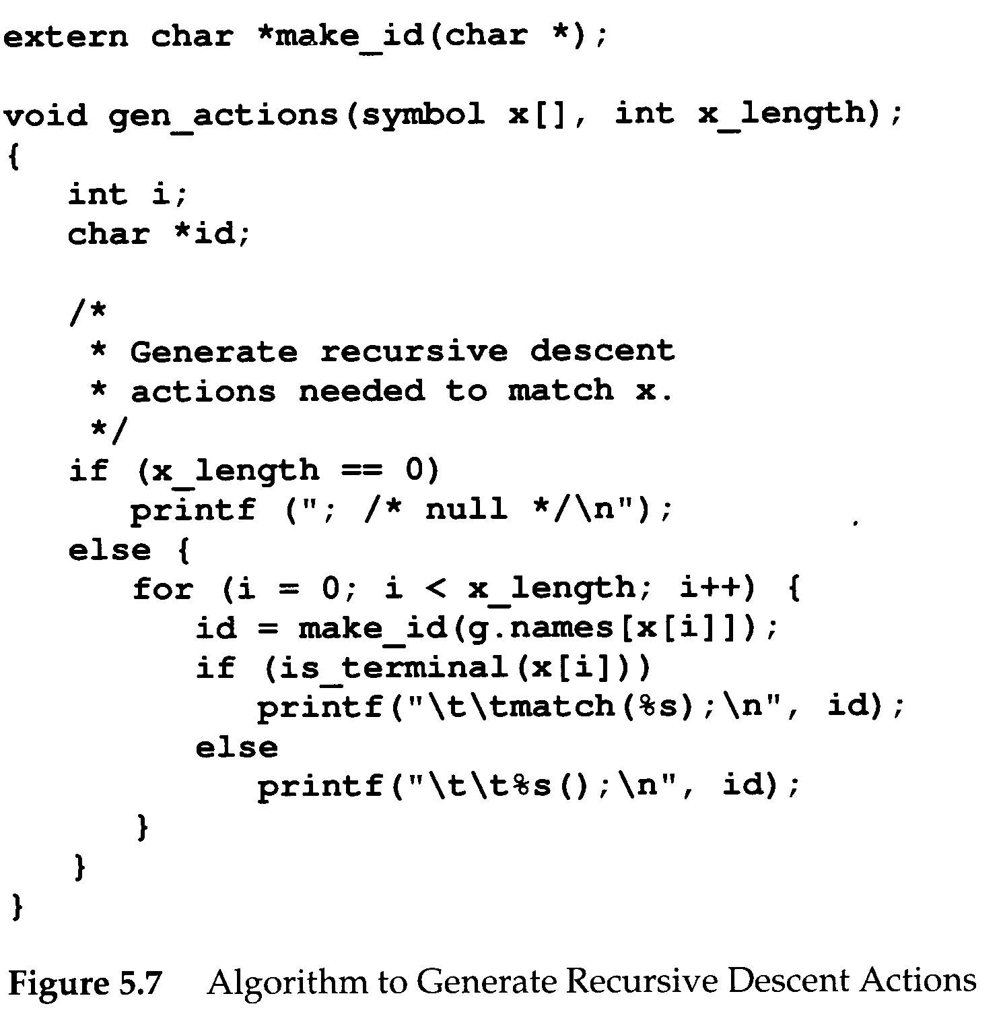
Building Recursive Descent Parsers from LL(1) Tables
gen_actions()
Takes the grammar symbols and generates the actions necessary to match them in a recursive descent parse

Slide 30
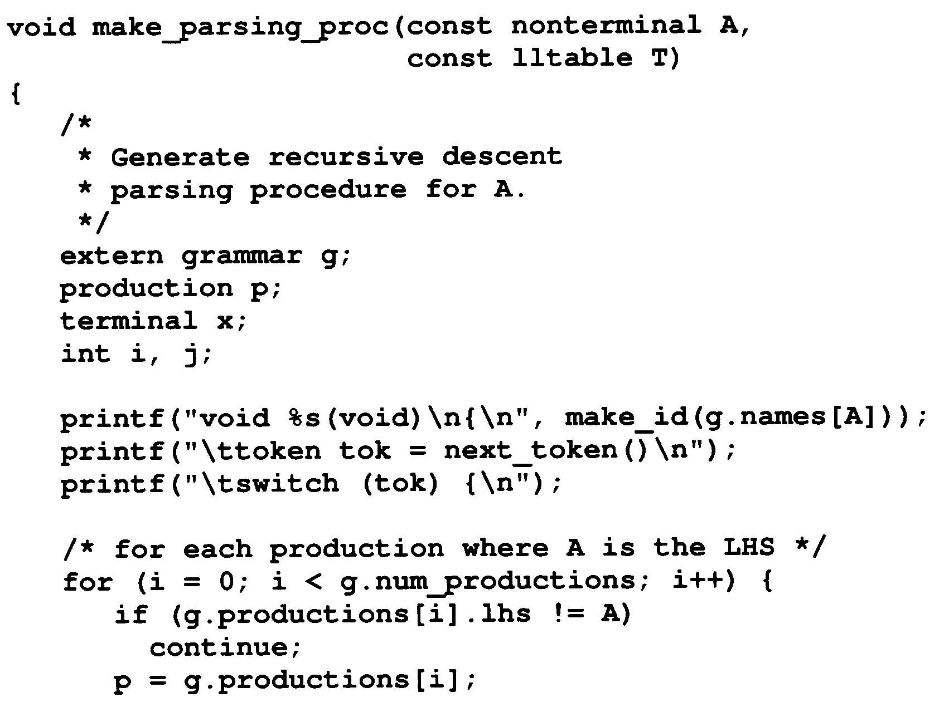
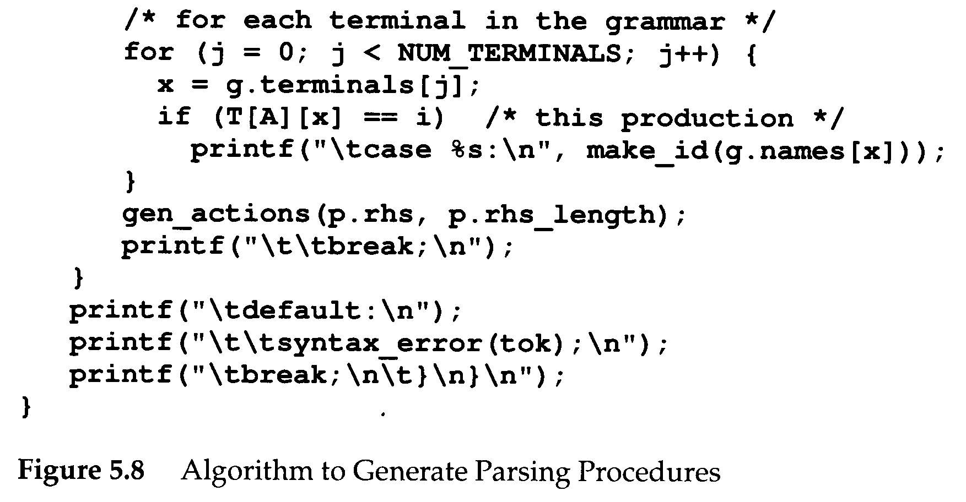

Slide 31

LL(1) Parsing
S
(
S
)
S
$$λ$$
𝜆
$$λ$$
𝜆
$S→\left(S\right)S$
$S→λ$
Input String: ()
-----------------------------
$S⟹_{lm}\left(S\right)S⟹_{lm}()S⟹_{lm}()$

Slide 32
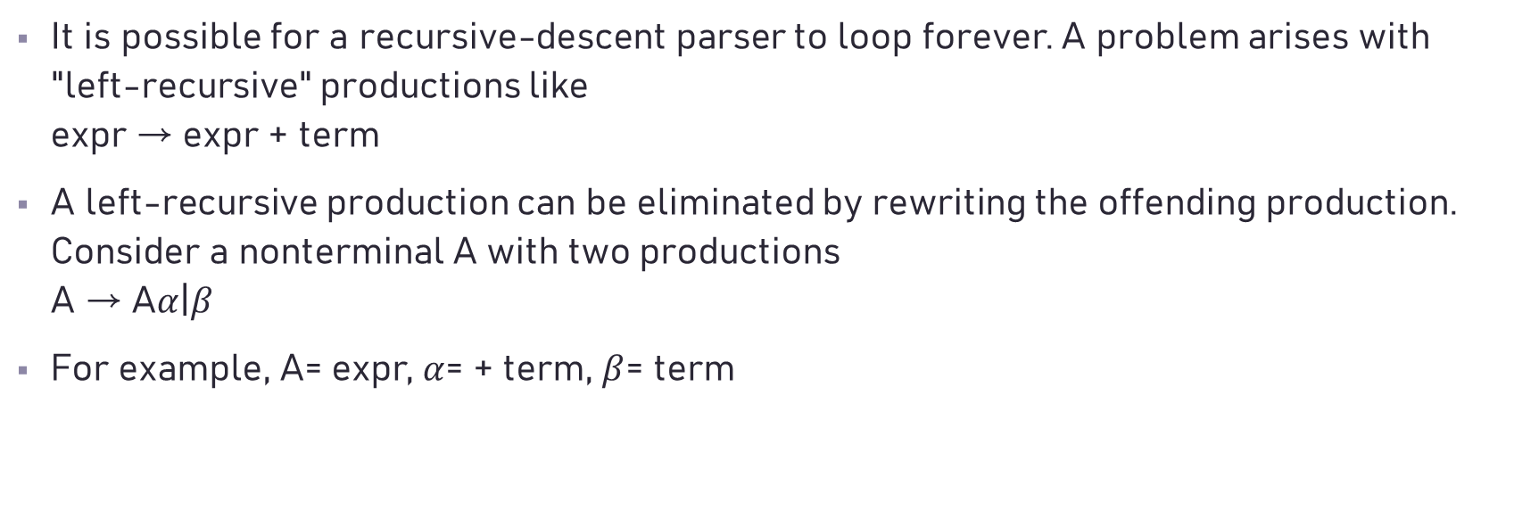
Elimination of Left Recursion
It is possible for a recursive-descent parser to loop forever. A problem arises with "left-recursive" productions like expr → expr + term
A left-recursive production can be eliminated by rewriting the offending production. Consider a nonterminal A with two productions A → A$α$|$β$
For example, A= expr, $α$= + term, $β$= term

Slide 33
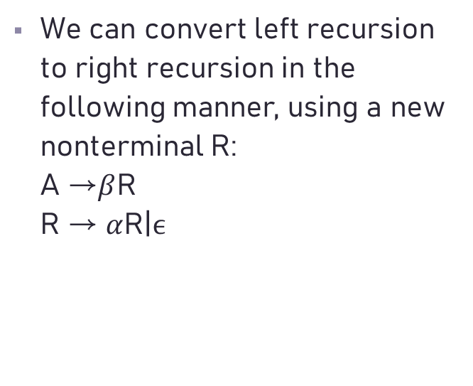
Elimination of Left Recursion
We can convert left recursion to right recursion in the following manner, using a new nonterminal R: A →$β$R R → $α$R|$ϵ$

Slide 34
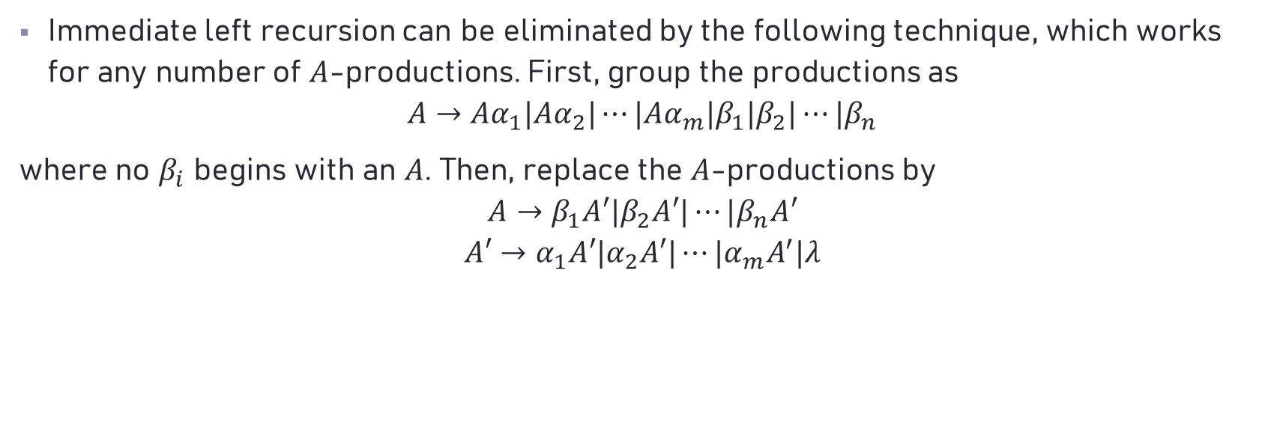
Elimination of Immediate Left Recursion
Immediate left recursion can be eliminated by the following technique, which works for any number of $A$-productions. First, group the productions as
$$A→Aα_{1}|Aα_{2}|⋯|Aα_{m}|β_{1}|β_{2}|⋯|β_{n}$$
where no $β_{i}$ begins with an $A$. Then, replace the $A$-productions by
$$A→β_{1}A′|β_{2}A′|⋯|β_{n}A′$$
$$A′→α_{1}A′|α_{2}A′|⋯|α_{m}A^{′}|λ$$

Slide 35

e.g.
$E→E+T | T$ $$T → T∗F | F \\ F→\left(E\right)| id$$
After transformation:
$$E→TE′ E′→+TE′ | λ$$
$$T→FT′ T′→∗FT′ | λ$$
$$F→(E) | id$$

Slide 36

How about left recursion occurred for derivation with more than two steps?
e.g., $S → Aa | b A → Ac | Sd | e$
where $S ⟹ Aa ⟹ Sda$

Slide 37
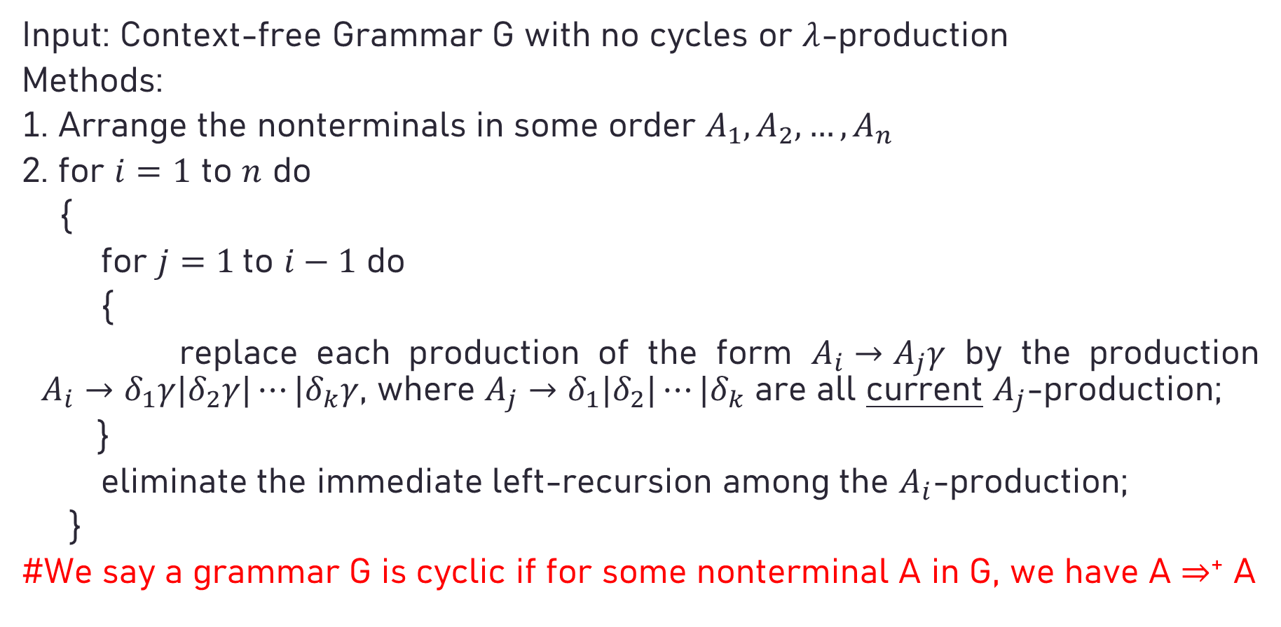
Algorithm: Eliminating left recursion
Input: Context-free Grammar G with no cycles or $λ$-production
Methods:
1. Arrange the nonterminals in some order $A_{1},A_{2}, …,A_{n}$
2. for $i=1$ to $n$ do
{
for $j=1$to $i−1$ do
{
replace each production of the form $A_{i}→A_{j}γ$ by the production $A_{i}→δ_{1}γ|δ_{2}γ|⋯|δ_{k}γ$, where $A_{j}→δ_{1}|δ_{2}|⋯|δ_{k}$ are all current $A_{j}$-production;
}
eliminate the immediate left-recursion among the $A_{i}$-production;
}
#We say a grammar G is cyclic if for some nonterminal A in G, we have A ⇒⁺ A

Slide 38

An Example
e.g.
$$S →Aa | b$$
$$A → Ac | Sd | e$$
Step 1: ==> $S → Aa | b$
Step 2: ==> $A → Ac | Aad | bd | e$
Step 3: ==> $A → bdA′ |eA′ A′ → cA′ |adA′ | $

Slide 39
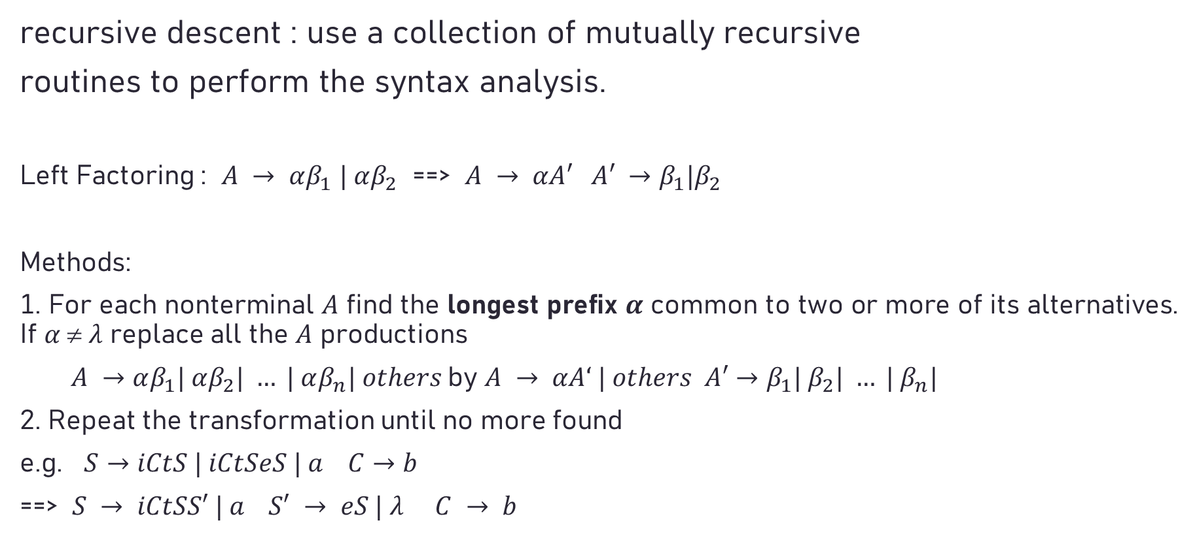
Non-backtracking (recursive-descent) parsing
recursive descent : use a collection of mutually recursive
routines to perform the syntax analysis.
Left Factoring : $A → αβ_{1} | αβ_{2}$ ==> $A → αA′ A′ →β_{1}|β_{2}$
Methods:
1. For each nonterminal $A$ find the longest prefix $α$ common to two or more of its alternatives. If $α  λ$ replace all the $A$ productions
$A →αβ_{1}| αβ_{2}| … | αβ_{n}| others$by $A → αA‘ | others A′→β_{1}| β_{2}| … | β_{n}|$
2. Repeat the transformation until no more found
e.g. $S→iCtS | iCtSeS | a C→b$
==> $S → iCtSS′ | a S′ → eS | λ C → b$

Slide 40
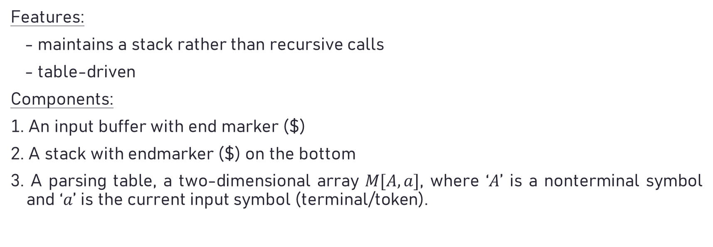
Predicative Parsing
Features:
- maintains a stack rather than recursive calls
- table-driven
Components:
1. An input buffer with end marker ($)
2. A stack with endmarker ($) on the bottom
3. A parsing table, a two-dimensional array $M[A,a]$, where ‘$A$’ is a nonterminal symbol and ‘$a$’ is the current input symbol (terminal/token).

Slide 41
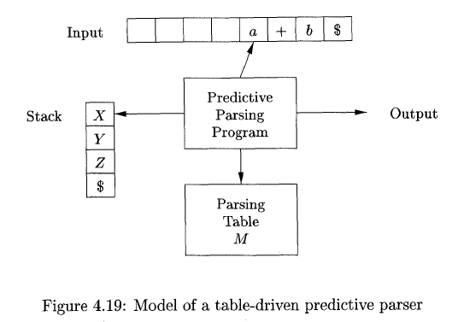

Slide 42





Parsing Table
$$M[A,a]$$
(
)
$
$$S$$
$$S → ( S ) S$$
$$S → λ$$
$S → λ$

Slide 43

Algorithm:
Input: An input string $w$ and a parsing table $M$ for grammar $G$.
Output: A leftmost derivation of $w$ or an error indication.

Slide 44
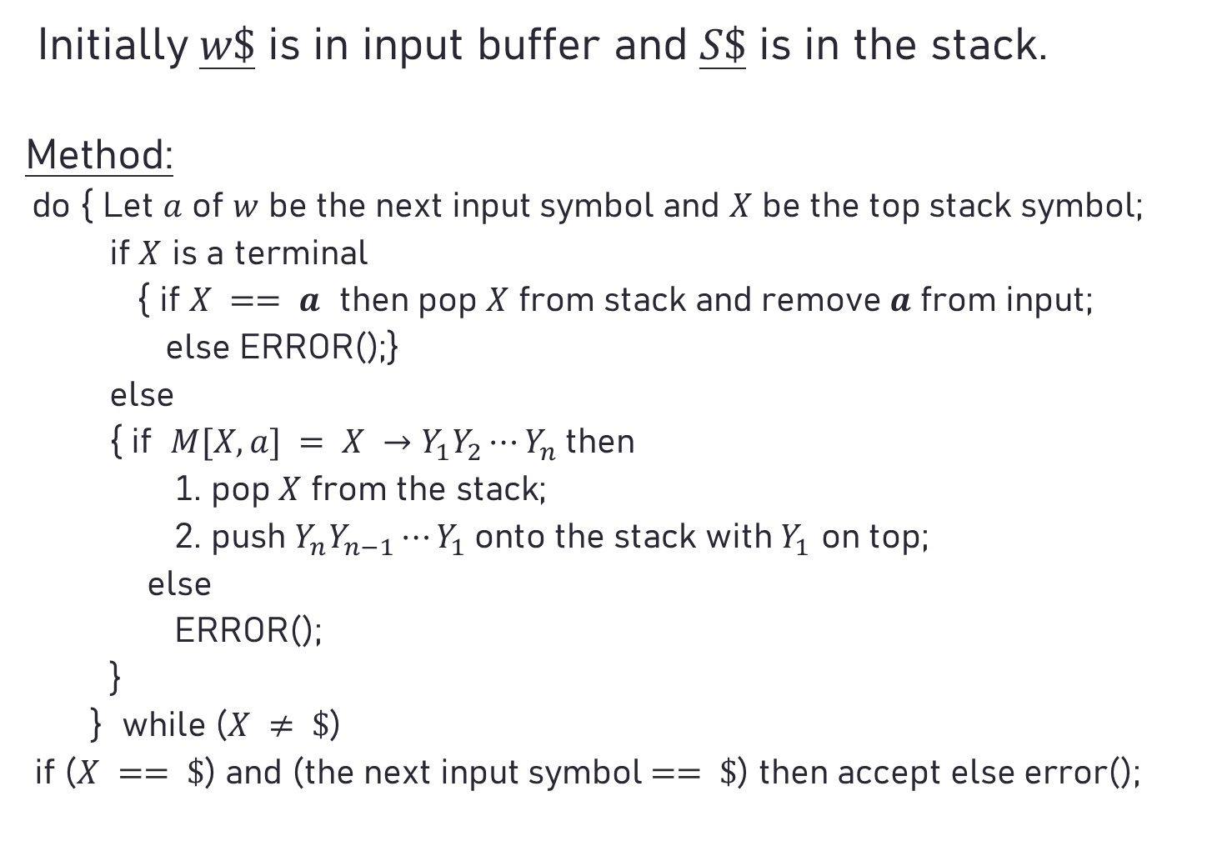
Initially $w\$$ is in input buffer and $S\$$ is in the stack.
Method:
do { Let $a$ of $w$ be the next input symbol and $X$ be the top stack symbol;
if $X$ is a terminal
{ if $X == a$ then pop $X$ from stack and remove $a$ from input;
else ERROR();}
else
{ if $M[X, a] = X →Y_{1}Y_{2}⋯Y_{n}$then
1. pop $X$ from the stack;
2. push $Y_{n}Y_{n−1}⋯Y_{1}$onto the stack with $Y_{1}$ on top;
else
ERROR();
}
} while ($X ≠ \$$)
if ($X == \$$) and (the next input symbol $== \$$) then accept else error();
Starting Symbol of the grammar

Slide 45
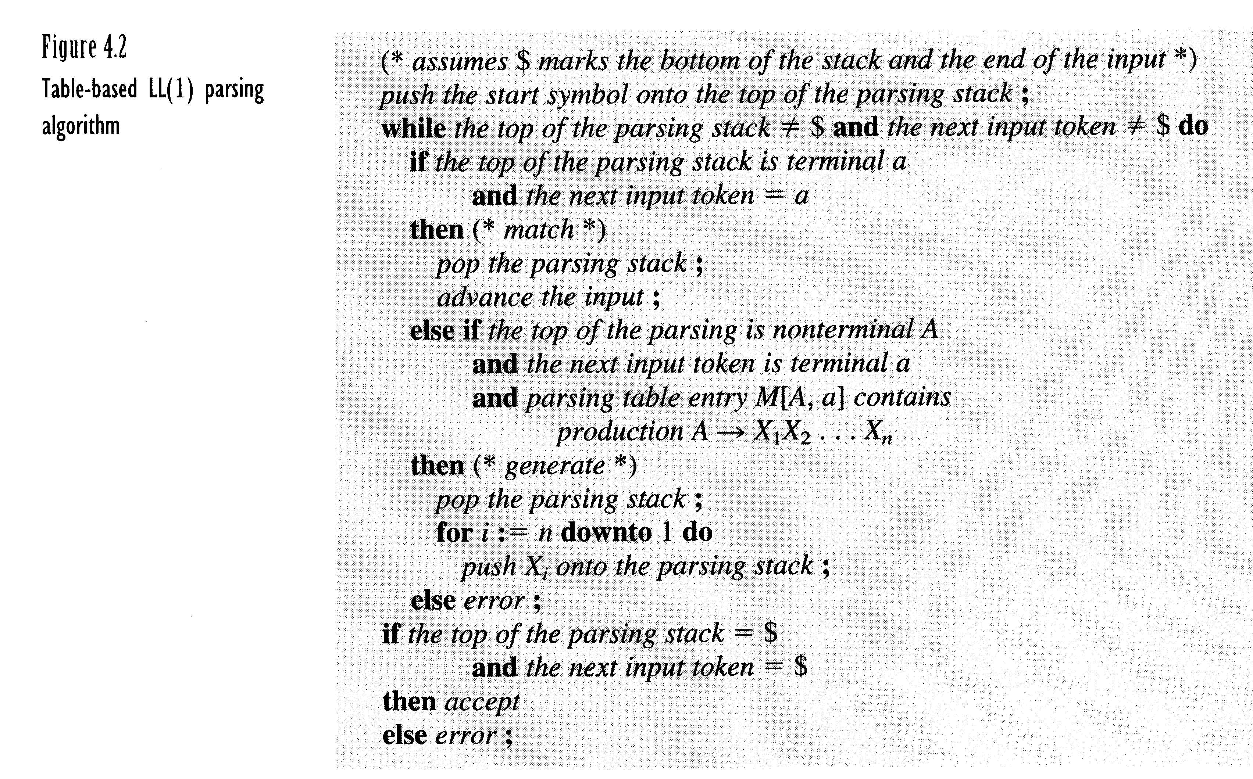

Slide 46
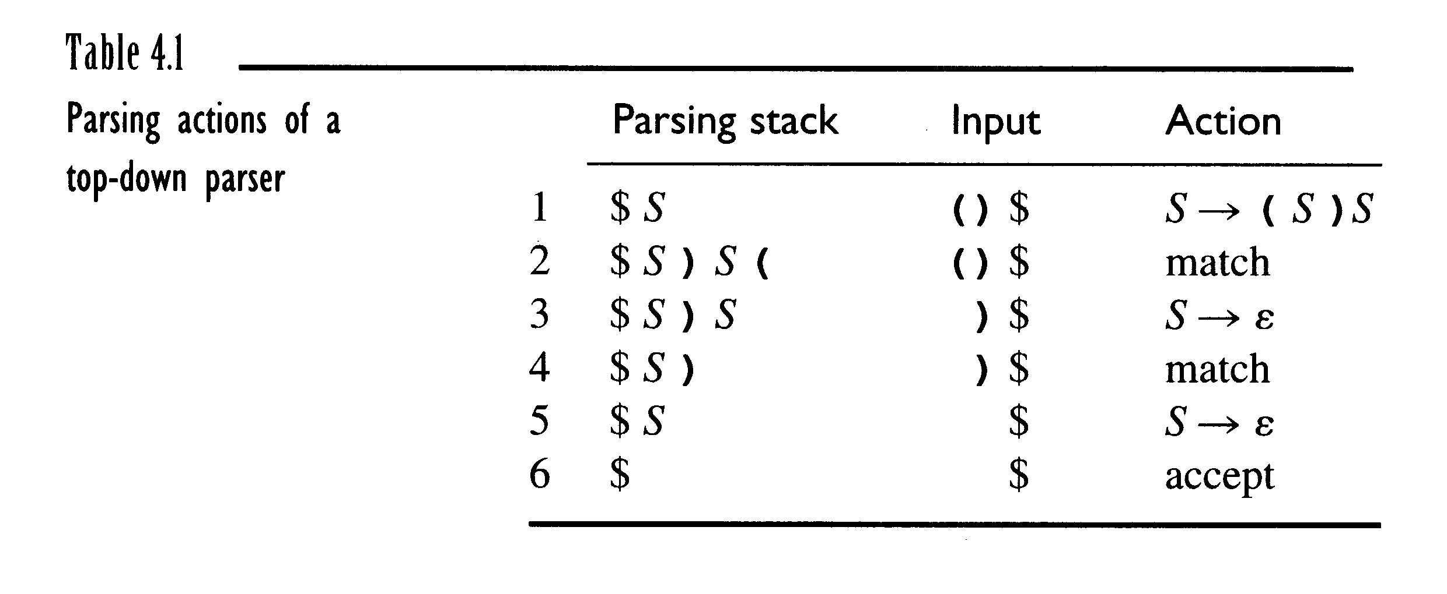
$$M[A,a]$$
(
)
$
$$S$$
$$S → ( S ) S$$
$$S → λ$$
$S → λ$

Slide 47
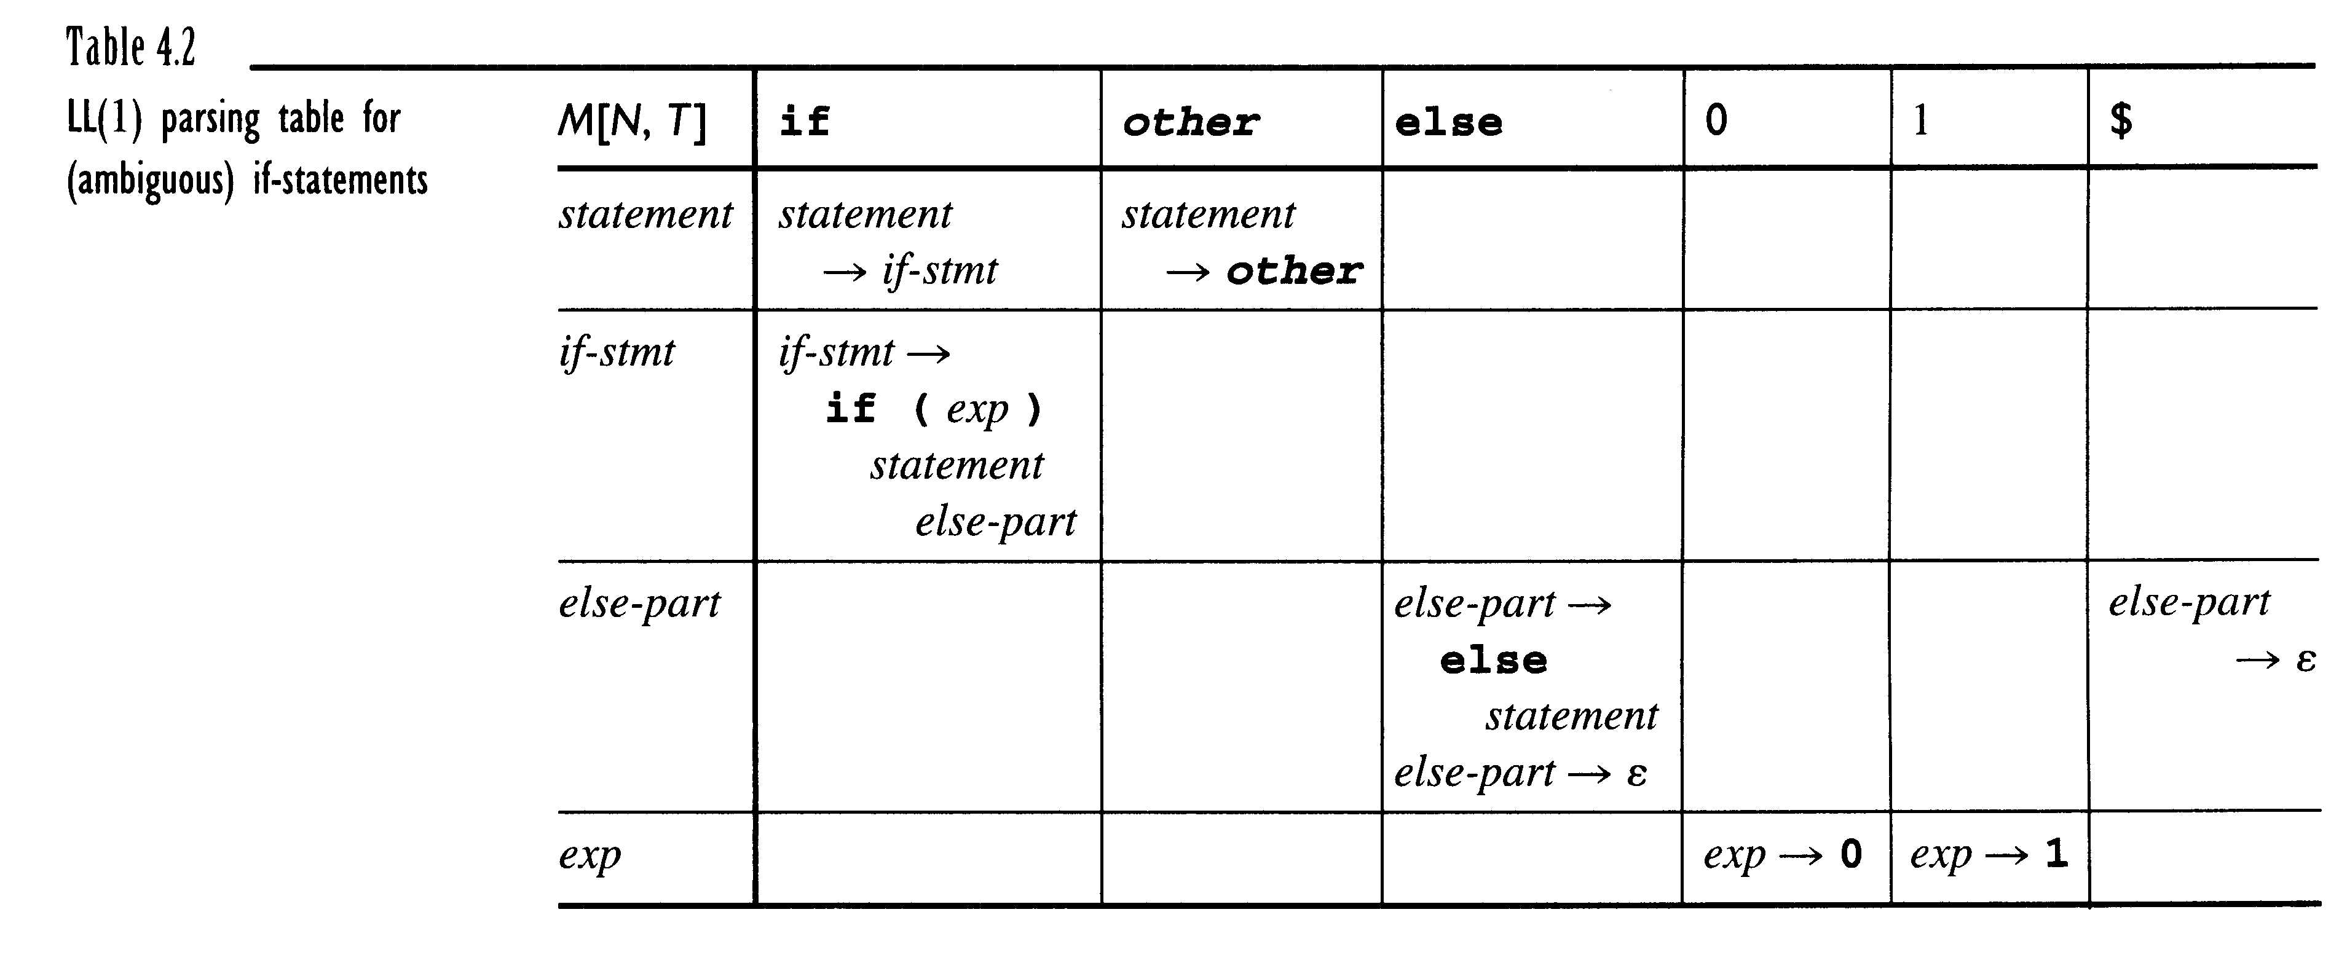
Start →statement $
First(state) ={if, other}
First(if-stmt)={if}
First(else-part)={else, ε}
First(exp)={0.1}
Follow(state)={$, else}
Follow(if-stmt)={$ , else}
Follow(else-part)={$, else}
Follow(exp)={)}

Slide 48

Construct a Predicative Parsing Table
1. For each production $A→$of the grammar, do steps 2 and 3.
2. For each terminal $a$ in $First()$, add $A→$ to $M[A, a]$.
3. If $λ$ is in $First()$, add $A→$ to $M[A, b]$ for each terminal $b$ in $Follow(A)$.
4. Make each undefined entry of $M$ be error.

Slide 49
LL(1) grammar
A grammar whose parsing table has no multiply-defined entries is said to be LL(1).
First 'L' : scan the input from left to right.
Second ‘L’ : produce a leftmost derivation.
'1' : use one input symbol to determine parsing
action.
* No ambiguous or left-recursive grammar can be LL(1).

Slide 50
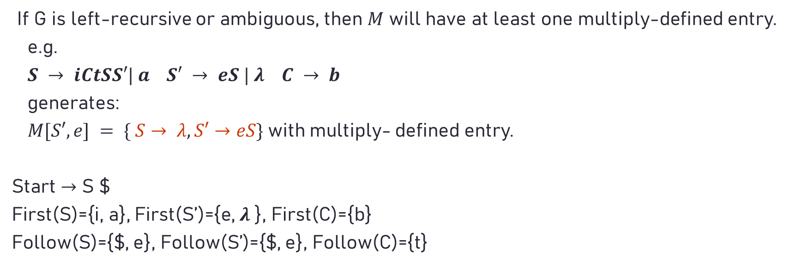
Def. for Multiply-defined entry
If G is left-recursive or ambiguous, then $M$ will have at least one multiply-defined entry.
e.g.
$S → iCtSS′| a S′ → eS | λ C → b$
generates:
$M[S′,e] = \{ S→ λ, S′→eS\}$with multiply- defined entry.
Start $→$ S $
First(S)={i, a}, First(S’)={e, $λ$}, First(C)={b}
Follow(S)={$, e}, Follow(S’)={$, e}, Follow(C)={t}

Slide 51
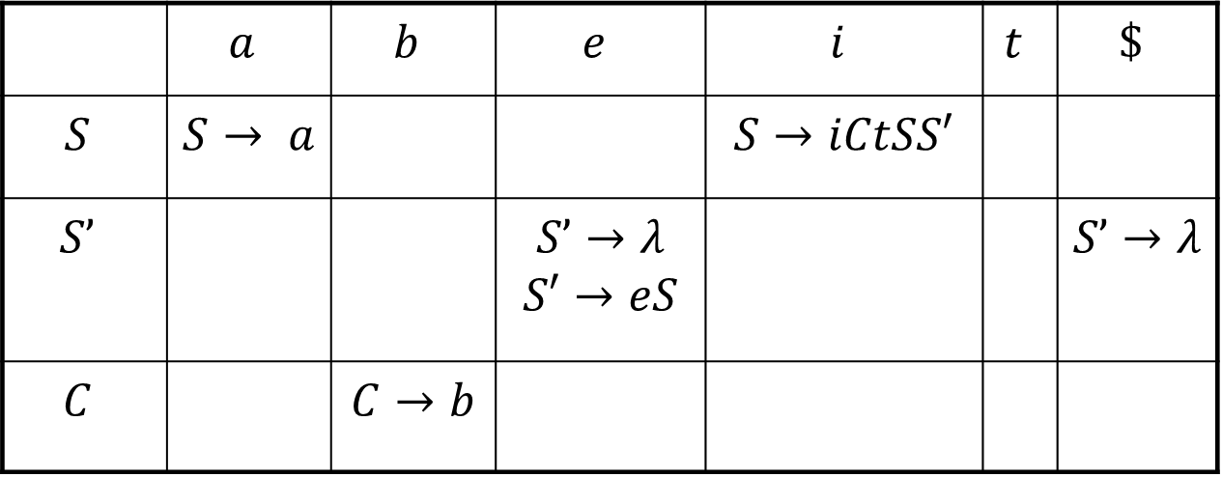
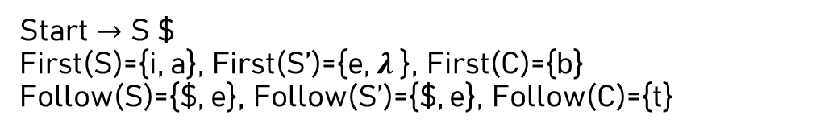
Parsing table with multiply-defined entry
 | $$a$$ | $$b$$ | $$e$$ | $$i$$ | $$t$$ | $$\$$$
$$S$$ | $$S→ a$$ |  |  | $$S→iCtSS′$$
$$S’$$ |  |  | $$S’→λ$$ $$S′→eS$$ |  |  | $$S’→λ$$
$$C$$ |  | $$C→b$$
$$S → iCtSS′| a S′ → eS | λ C → b$$
Start $→$ S $
First(S)={i, a}, First(S’)={e, $λ$}, First(C)={b}
Follow(S)={$, e}, Follow(S’)={$, e}, Follow(C)={t}

